Slide 1



Walmart Store’s Sales Forecasting
Exploring the impact of technology on society

Slide 2


Introduction
Sales forecasting is the process of estimating the future sales of a product or service. It is a crucial part of any company and its business plan, as it helps businesses make informed decisions about resource allocation, marketing strategy, and investment. In this article, we will apply regression analysis for sales forecasting on a dataset provided by Walmart.

Slide 3
System Analysis: Overview Of The Previous Model
01
02
03
04
Sales forecasting typically involves leveraging historical data, economic factors, and machine learning models to predict future sales trends for improved decision-making.
Assumption Risks: Models are built on assumptions about future conditions, and if those assumptions are incorrect, the predictions may be inaccurate.
Human Factors: Models might not account for human behavior, such as sudden changes in consumer preferences or the impact of marketing campaigns, leading to deviations from predicted sales.
Technological Challenges: Implementing and maintaining advanced forecasting models might require significant technological infrastructure and expertise, which may not be feasible for all businesses.

Slide 4
Proposed Model: Connection and global community
In this project, we will use the weekly sales data provided by Walmart. It consists of historical sales data for 45 Walmart stores located in different regions. Each store contains a number of departments, and our objective is to predict the department-wide sales for each store. We will apply regression analysis to forecast the sales for each department based on multiple factors, such as temperature, fuel price, store type, CPI, employment index, etc.

Slide 5
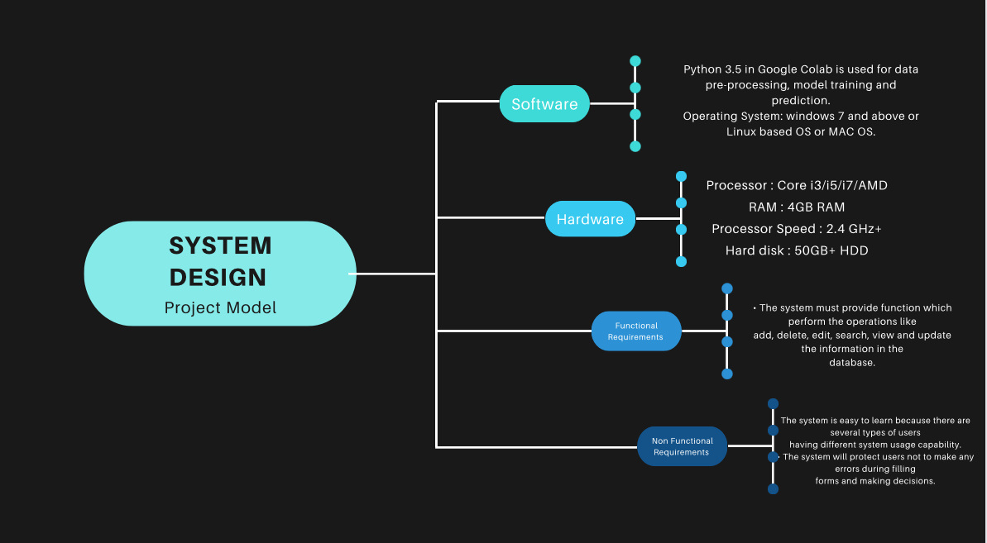

Slide 6
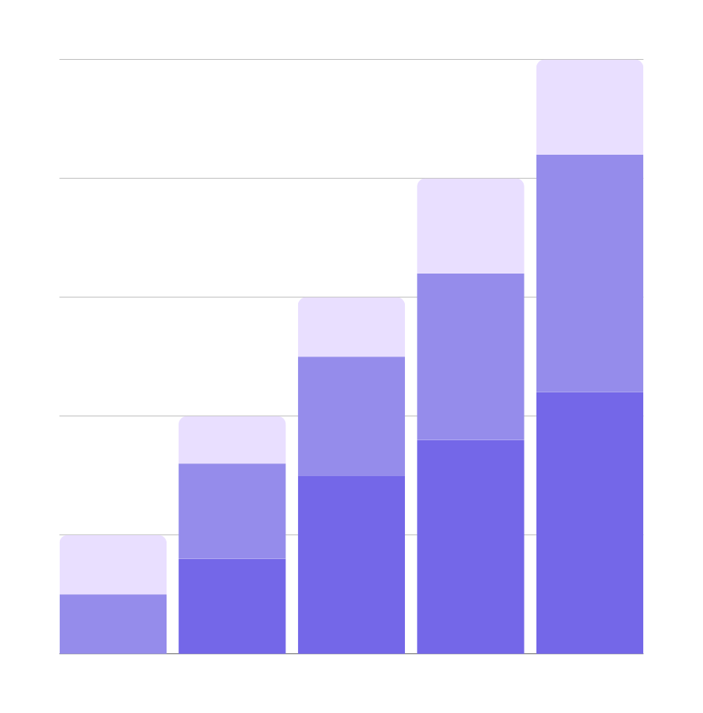
How The Model Is Built
We will handle missing values present in the dataset during the data cleaning stage.
We will perform exploratory data analysis (EDA) using various visualization techniques to identify underlying patterns and correlations that can help us derive insights.
Further, we will train and develop multiple regressor ML models, such as KNN Regressor, Decision Tree Regressor, Random Forest Regressor, and XGBoost Regressor model and compare their performance based on the model’s accuracy and RMSE

Slide 7


Pre-requisites
Requirements
Python
Data Visualization
Descriptive Statistics
Machine Learning
Data Cleaning and Preprocessing
Pandas
Numpy
Matplotlib
Seaborn
Sklearn

Slide 8
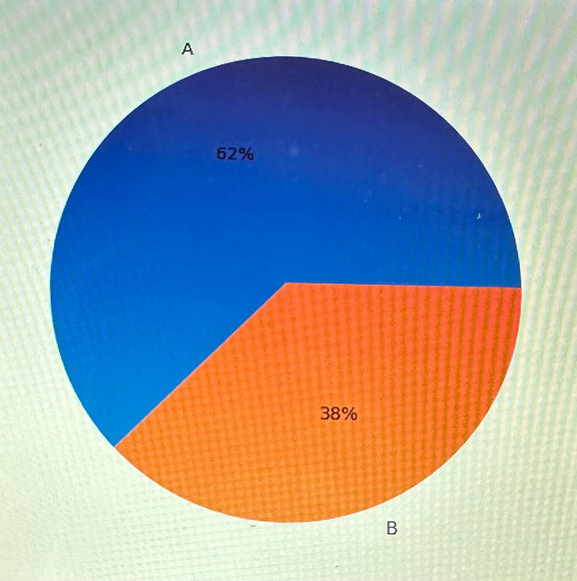
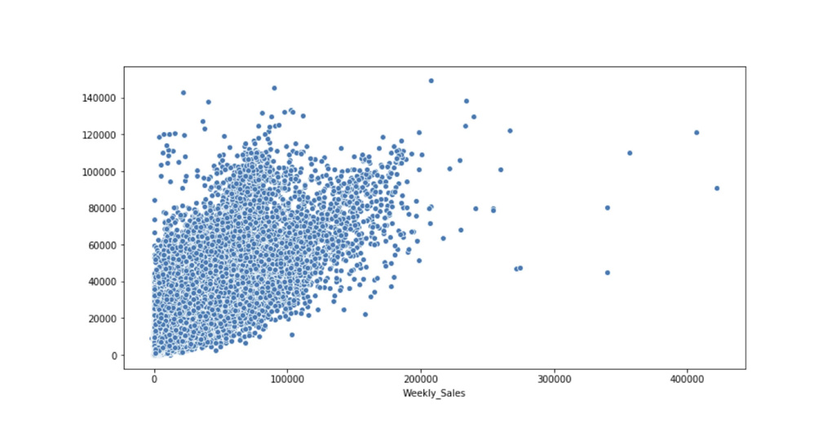
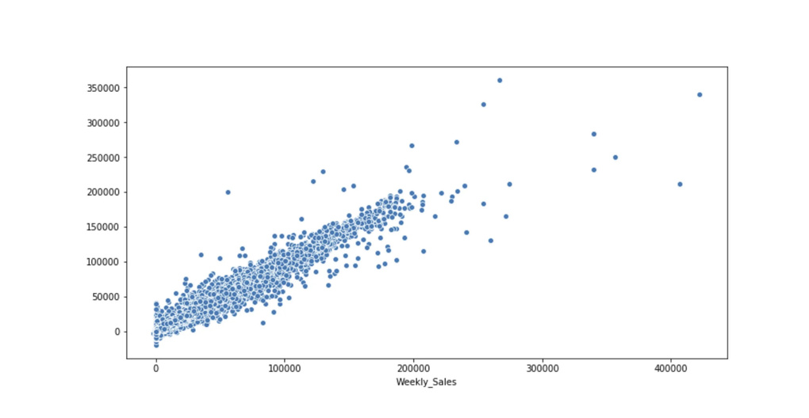
Ethical challenges in technology
01
02
03
Exploratory Data Analysis
Data Preprocessing
Developing ML Models

Slide 9
Conclusion: Towards a sustainable future in the digital age
In conclusion, sales forecasting plays a crucial role in the success of any business. It offers several advantages that can guide decision-making, enhance operational efficiency, and maximize profitability
Overall, while sales forecasting offers significant advantages in terms of strategic decision-making, resource allocation, and performance evaluation, it is crucial to recognize its limitations.

Slide 10

Thank you very much!

